Slide 1
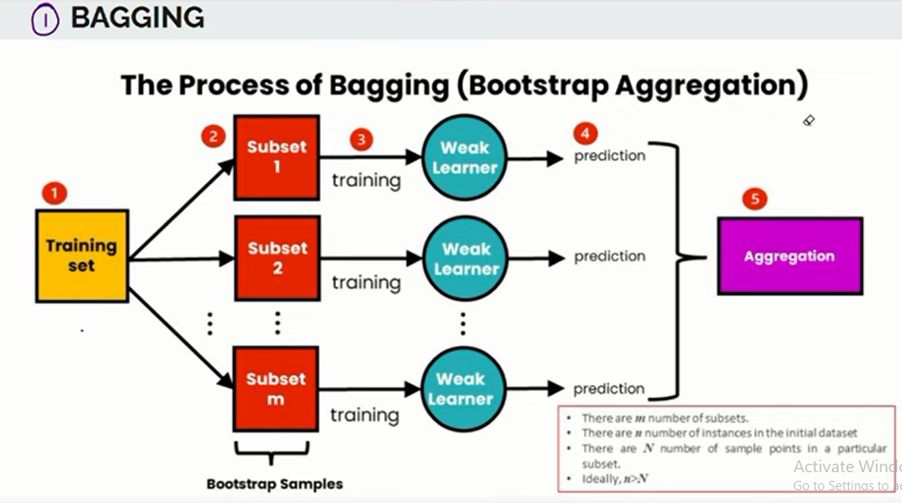
Ensemble Machine Learning Approach
1.Bagging 2. Boosting 3. Stacking

Slide 2
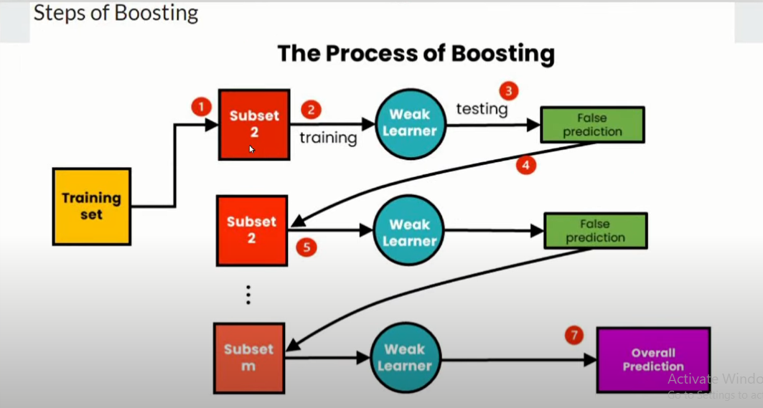

Slide 3
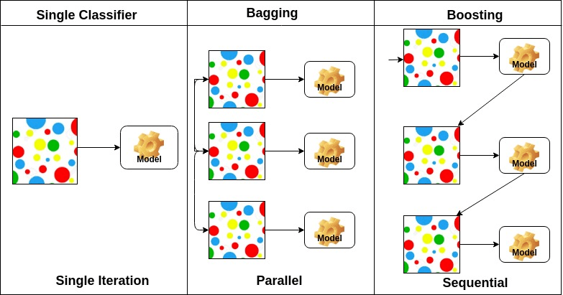

Slide 4
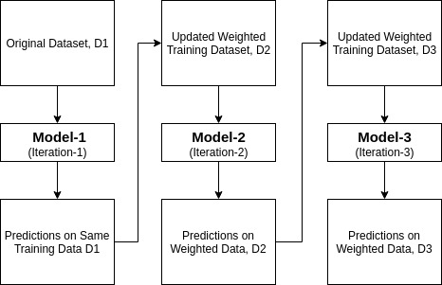
Adaboost

Slide 5
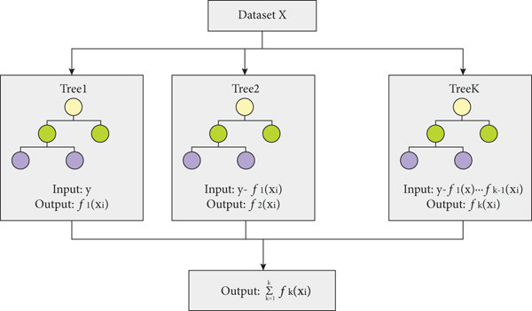
XG Boost

Slide 6
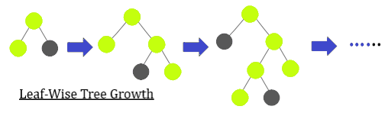
Light Gradient Boosting Machine (LGBM)

Slide 7
